Slide 1
C Programming Memory Management
Week 2

Slide 2
Agenda
C Memory model
Heap usage
C Demos
Endianness

Slide 3
Agenda
C Memory model
Heap usage
Endianness

Slide 4

Memory: the C Story
C offers a story both simpler and more complex than Java
Memory is a sequence of bytes, read/written by providing an address
Addresses are values manipulated using arithmetic & logic operations
Memory can be allocated:
Statically
on the stack
Dynamically on the heap
Heap
0x1000434

Slide 5
Static and Stack allocation
Static allocation with the keyword static
Stack allocation automatic by the compiler for local variables
printf can display the address of any identifier
#include <unistd.h> #include <stdio.h>
static int sx; static int sa[100]; static int sy;
int main() { int lx;
static int sz;
printf("%p\n", | &sx); | 0x100001084
printf("%p\n", | &sa); | 0x1000010a0
printf("%p\n", | &sy); | 0x100001230
printf("%p\n", | &lx); | 0x7fff5fbff58c
printf("%p\n", | &sz); | 0x100001080
printf("%p\n", | &main); | 0x100000dfc

Slide 6
Static and Stack allocation
Any value can be turned into a pointer
static | int | sx;
static | int | sa[100];
static | int | sy;
Arithmetics on pointers allowed
int main() {
for(p= (int*)0x100001084;
p <= (int*)0x100001230; p++)
{
*p = 42;
}
printf("%i\n",sx);
Nothing prevents a program from writing all over memory
42
42
42
printf("%i\n",sa[0]);
printf("%i\n",sa[1]);

Slide 7
Memory Structure
Main memory can be thought of as a large array of bytes.
When running a C program, memory assignments largely fall under four distinct "chunks":
Stack
Heap
Static/data
Text/Code
Generally speaking, you don't use all 2³² bytes; if you try to access a random memory address you didn't get assigned, your code will likely crash. This is known as a segmentation fault
0xFFFF...FFF
Stack
Heap
Static/data
Code/text
0x0000...000
Notes:
Some classes, like CS162, uses bottom-up diagrams which is effectively the same as top-down structurally, but the top of the diagram is 0x000...00 and the bottom is 0xFFF...FF (the rest of memory looks like code → static → heap → stack). In that case, the stack grows "up" and the heap grows "down" visually speaking, but value-wise, you still would subtract values to get more recent stack addresses.
As a note, RWX memory is much rarer nowadays because having write-execute permissions opens up a whole can-o' worms for hackers/malicious users as they could write something malicious to memory and then subsequently execute it (bad).

Slide 8
Memory Structure
Code/text
One of the key advancements in CS was to design programs as software instead of hardware.
Instead of messing with wires to program a computer, you can just write your program as data
The code segment stores the actual bytecode that comprises your program.
Fixed size, ideally never changed after loading the program
Includes some constants!
Constants that are considered "built-in" to the code
Ex. x = y + 1; the 1 is part of the code.
0xFFFF...FFF
0x0000...000

Slide 9
Memory Structure
Static/data
Main idea: It's possible to do some analysis before the code starts running to determine a set of variables that must be allocated space. The data segment contains as many of those variables as possible.
Fixed size, for efficiency. Two main data values:
Global variables (you only ever need one copy of a global variable, so fixed size)
String literals (you can determine how many string literals there are in a program)
0xFFFF...FFF
0x0000...000

Slide 10
Memory Structure
Stack
Every function call sets aside some space on the stack for its local variables (plus some metadata)
Designed for temporary storage; after a function returns, all data in that function's stack frame gets freed
Variable sizeof the stack; grows downward as you call functions and shrinks as you return from functions
Stack frame has
Locals
Parameters to function
Return address
Static link
Dynamic link
SP is used to access variables in stack frame
0xFFFF...FFF
Stack pointer (sp)
0x0000...000

Slide 11
Memory Structure
Heap
For any variables that need to persist across functions, the heap is available
In C, all heap memory must be manually allocated; a C program won't allocate heap space unless you tell it to explicitly.
Similarly, heap memory is only freed when manually requested; if you forget to free something, it takes up heap space forever
Grows upward as memory is allocated
Often the source of a lot of bugs when starting off working with C.
0xFFFF...FFF
Stack pointer (sp)
Heap pointer (hp)
0x0000...000

Slide 12
Agenda
C Memory model
Heap usage
C Demos
Endianness

Slide 13
Heap Usage
The heap is run by a memory manager, which is part of the operating system (or OS)
In order to use the heap, our program needs to request memory from the OS, and promises to return that memory when it's no longer needed.

Slide 14
Dynamic memory management
#include <stdlib.h>
void* malloc(size_t s)
void* calloc(size_t n, size_t s)
void free(void* p)
void* realloc(void* p, size_t s)
Allocate and free dynamic memory

Slide 15
malloc(size_t s)
Allocates s bytes and returns a pointer to the allocated memory.
Memory is not cleared
Returned value is a pointer to alloc’d memory or NULL if the request fails
You must cast the returned pointer
It is a void*
p = (char*) malloc(10); /* allocated 10 bytes */
if(p == NULL) { /*panic*/ }
CAN FAIL, CHECK THE RETURNED POINTER NOT NULL
Return a void*
Notes:
Requests n consecutive bytes from the memory manager. The memory manager finds a block of open space and reserves that space for your personal use. This is known as a Memory ALLOCation.
Does NOT clean out any data that used to be there (garbage data)
If the memory manager can't find enough memory, returns a NULL pointer

Slide 16
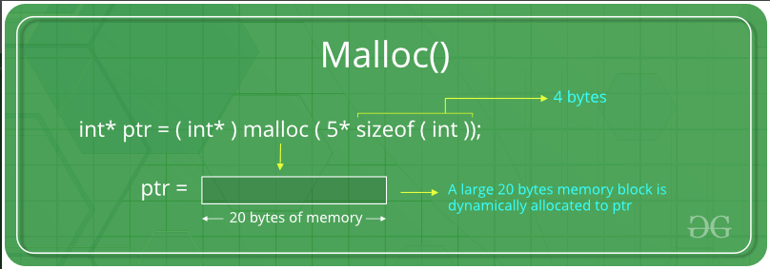
malloc(size_t s)

Slide 17
calloc(size_t n, size_t s)
Allocates memory for an array of n elements of s bytes each and returns a pointer to the allocated memory.
The memory is set to zero
The value returned is a pointer to the allocated memory or NULL
p = (char*) calloc(10,1); /*alloc 10 bytes */
if(p == NULL) { /* panic */ }
CAN FAIL, CHECK THE RETURNED POINTER NOT NULL
What’s the difference between int array[10] and calloc(10,4)
Notes:
Allocates (nitems * size) bytes of data, and guarantees that the returned block is cleared (Clear ALLOCation)
Two main ways the memory manager does this:
Find a block that's already empty
Run malloc, then clear the block by zeroing out its contents

Slide 18
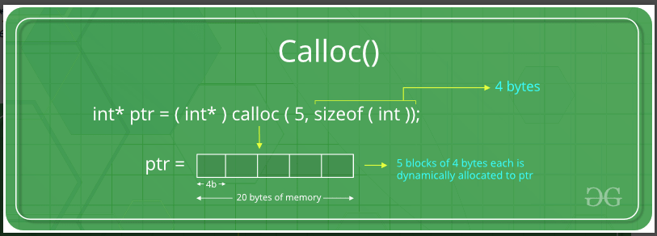
calloc(size_t n, size_t s)

Slide 19
free(void* p)
Frees the memory space pointed to by p, which must have been allocated with a previous call to malloc, calloc or realloc
If memory was not allocated before, or if free(p) has already been called before, undefined behavior occurs.
If p is NULL, no operation is performed.
free() returns nothing
char *mess = NULL;
mess = (char*) malloc(100);
…
free(mess); *mess = 43;
FREE DOES NOT SET THE POINTER TO NULL
Notes:
Gives the block pointed to by ptr back to the memory manager
ptr MUST be a pointer that was returned by the memory manager earlier that hasn't been freed; if you free a pointer to the stack, a pointer in the middle of an allocated block, or a pointer that was already freed, your code crashes
Does NOT clean out any data you put in the allocated block

Slide 20
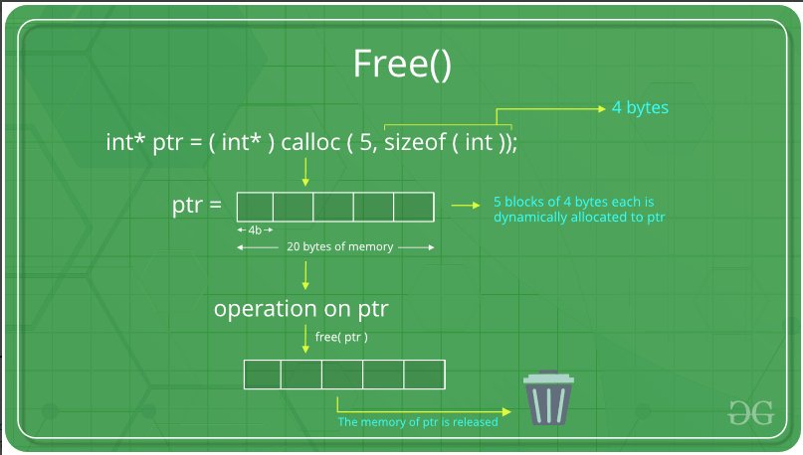
free()

Slide 21
realloc(void* p,size_t s)
Changes the size of the memory block pointed to by p to s bytes
Contents unchanged to the minimum of old and new sizes Newly alloc’d memory is uninitialized.
Returns pointer to alloc’d memory, may be different from p, or NULL if the request fails or if s==0
If fails, original block left untouched, i.e. it is not freed or moved
Notes:
"Resizes" the block pointed to by ptr, so that it now contains n bytes.
ptr must be a pointer that was returned by the memory manager
Most of the time, it just resizes the box and returns the same pointer back. However, if it can't do so (ex. if the data immediately after the malloc'ed block is already allocated), the memory manager can choose to move the block to a new place in memory, freeing the old pointer.
Otherwise, acts as malloc; newly allocated memory contains garbage, and realloc returns NULL if it can't find a new block.

Slide 22
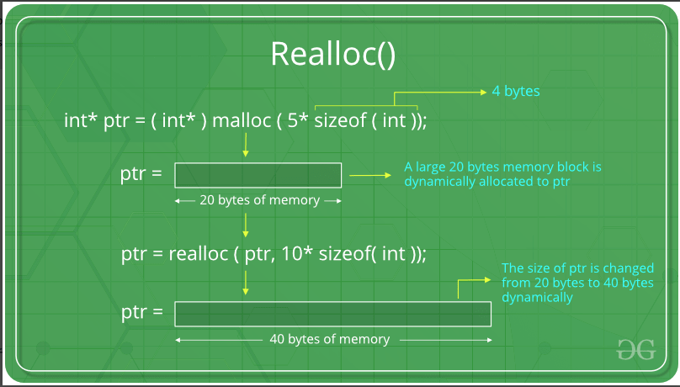
realloc(void* p,size_t s)

Slide 23
memcpy(void*dest,const void*src,size_t n)
Copies n bytes from src to dest
Returns dest
Does not check for overflow on copy
char buf[100];
char src[20] = “Hi there!”;
int type = 9;
memcpy(buf, &type, sizeof(int));/* copy an int*/
memcpy(buf+sizeof(int), src, 10); /*copy 10 chars*/

Slide 24
memset(void *s, int c, size_t n)
Sets the first n bytes in s to the value of c
(c is converted to an unsigned char)
Returns s
Does not check for overflow
memset(mess, 0, 100);

Slide 25
Heap Example
int* i = (int*)malloc(sizeof(int) * 5); for(int j = 0; j < 5; j++)
i[j] = j; int* k = (int*)calloc(3, sizeof(int)); i = (int*) realloc(i, sizeof(int)*2); i = (int*) realloc(i, sizeof(int)*10); free(k); k = (int*)malloc(sizeof(int)*6); for(int j = 0; j < 5; j++) k[j] = j; free(i); free(k);
Notes:
This example was run on the whiteboard during lecture, showing how memory behaves in response to this. The last line errors.

Slide 26
Best practices for memory use
Always free the dynamic memory
free() is not recursive
Define constructors and destructor for complex data structures
Memory in stack frame is reclaimed upon function return
Heap has fragmentation problem
Uses linked list to store data
Heap allocation and access is slow
As compared to stack
Stack memory is limited
Uses LIFO to store data

Slide 27
Memory Allocation Problems
Memory leaks
Alloc’d memory not freed appropriately
If your program runs a long time, it will run out of memory or slow down the system
Always add the free on all control flow paths after a malloc
void *ptr = malloc(size);
/*the buffer needs to double*/
size *= 2;
ptr = realloc(ptr, size); if (ptr == NULL)
/*realloc failed, original address in ptr lost; a leak has occurred*/
return 1;

Slide 28
Memory Allocation Problems
Use after free
Using dealloc’d data
Deallocating something twice
Deallocating something that was not allocated
Can cause unexpected behavior. For example, malloc can fail if “dead” memory is not freed.
More insidiously, freeing a region that wasn’t malloc’ed or freeing a region that is still being referenced
Use after free
Using dealloc’d data
Deallocating something twice
Deallocating something that was not allocated
Can cause unexpected behavior. For example, malloc can fail if “dead” memory is not freed.
More insidiously, freeing a region that wasn’t malloc’ed or freeing a region that is still being referenced
int *ptr = malloc(sizeof (int)); free(ptr);
*ptr = 7; /* Undefined behavior */

Slide 29
Memory Allocation Problems
Memory overrun
Write in memory that was not allocated
The program will exit with segmentation fault
Overwrite memory: unexpected behavior
int* y= …
int* x= y+10;
for(int* p= x; p >=y; p++)
{
*p = 42;
}

Slide 30
Memory Allocation Problems
Fragmentation
The system may have enough memory but not in contiguous region
int* vals[10000];
int | i;
for | (i | = | 0; | i | < | 10000; | i++)
vals[i] = (int*) malloc(sizeof(int*));
for (i = 0; i < 10000; i = i + 2) free(vals[i]);

Slide 31
Checklist
NULL pointer at declaration
Verify malloc succeeded
Initialize alloc’d memory
free when you malloc
NULL pointer after free
Do not use memory after free

Slide 32
Agenda
C Memory model
Heap usage
Endianness

Slide 33
malloc vs calloc
Which is faster? How much? Why?

Slide 34
Memory Leak
What is memory leak?
What are best practices for memory management in C?

Slide 35
Uninitialized Memory
What happens when you try to access uninitialized memory?
What happens when you access memory after free()?

Slide 36
Agenda
C Memory model
Heap usage
C Demos
Endianness

Slide 37
Endianness
So far, we’ve discussed how we store values in binary
Ex. We write int i[] = {0x6472 6167, 0x7320 6E65, 0x7400 646F}.
If we assume &i == 0xF000 0000, then our memory would look something like this:
If we do i[1], the compiler adds 0xF000 0000 + 1 * sizeof(int) = 0xF000 0004, then takes the four bytes starting from that address as an integer. This corresponds to 0x73206E65, so it works.
What happens if we do ((char*) i)[2]?
Note: These slides follow a convention of using a new 0x prefix for every array element. Thus, 0x64726167 0x73206E65 0x7400646F is an array of 32-bit values, while 0x64 0x72 0x61 0x67 is an array of 8-bit values.
Address (Last hex digit) |  |  |  | 0 | 1 | 2 | 3 | 4 | 5 | 6 | 7 | 8 | 9 | A | B
Value |  |  |  | 0x64726167 |  |  |  | 0x73206E65 |  |  |  | 0x7400646F

Slide 38
Endianness
So far, we’ve discussed how we store values in binary
Ex. We write int i[] = {0x6472 6167, 0x7320 6E65, 0x7400 646F}.
If we assume &i == 0xF000 0000, then our memory would look something like this:
If we do ((char*) i)[2], the compiler adds 0xF000 0000 + 2 * sizeof(char) = 0xF000 0002, then takes the one byte starting from that address as a char. This yields something (since there is data there), but what it yields depends on how the subbytes of our 4-byte int get stored in memory. The way things get stored is known as the endianness of the system.
Address (Last hex digit) |  |  |  | 0 | 1 | 2 | 3 | 4 | 5 | 6 | 7 | 8 | 9 | A | B
Value |  |  |  | 0x64726167 |  |  |  | 0x73206E65 |  |  |  | 0x7400646F
Value |  |  |  | ? | ? | ? | ? | ? | ? | ? | ? | ? | ? | ? | ?

Slide 39
Big-Endian
In a big-endian system, we write the Most Significant Byte “first” (that is, in the lower address.
If we do ((char*) i)[2], the compiler adds 0xF000 0000 + 2 * sizeof(char) = 0xF000 0002, then takes the one byte starting from that address as a char. This yields 0x61.
If we do printf((char*) i); we would interpret this block of memory as a character array, so we’d get 0x64 0x72 0x61 …, which when converted to ASCII yields “drags net”
Address (Last hex digit) |  |  |  | 0 | 1 | 2 | 3 | 4 | 5 | 6 | 7 | 8 | 9 | A | B
Value |  |  |  | 0x64726167 |  |  |  | 0x73206E65 |  |  |  | 0x7400646F
Value |  |  |  | 0x64 | 0x72 | 0x61 | 0x67 | 0x73 | 0x20 | 0x6E | 0x65 | 0x74 | 0x00 | 0x64 | 0x6F

Slide 40
Little-Endian
In a little-endian system, we write the Least Significant Byte “first” (that is, in the lower address.
If we do ((char*) i)[2], the compiler adds 0xF000 0000 + 2 * sizeof(char) = 0xF000 0002, then takes the one byte starting from that address as a char. This yields 0x72.
If we do printf((char*) i); we would interpret this block of memory as a character array, so we’d get 0x67 0x61 0x72 …, which when converted to ASCII yields “garden sod”
Address (Last hex digit) |  |  |  | 0 | 1 | 2 | 3 | 4 | 5 | 6 | 7 | 8 | 9 | A | B
Value |  |  |  | 0x64726167 |  |  |  | 0x73206E65 |  |  |  | 0x7400646F
Value |  |  |  | 0x67 | 0x61 | 0x72 | 0x64 | 0x65 | 0x6E | 0x20 | 0x73 | 0x6F | 0x64 | 0x00 | 0x74

Slide 41
Endianness
Note: In either case, if we read i[1], we end up with our original integer. This is a good checksum to confirm your understanding; if you write a number, you should be able to read that number to get the same thing.
In Big Endian: the compiler adds 0xF000 0000 + 1 * sizeof(int) = 0xF000 0004, then takes the four bytes starting from that address: 0x73 0x20 0x6E 0x65. Since this is big-endian, we combine them with the first address being the MSB, so we get 0x73206E65, which is the correct result
Address (Last hex digit) |  |  |  | 0 | 1 | 2 | 3 | 4 | 5 | 6 | 7 | 8 | 9 | A | B
Value |  |  |  | 0x64726167 |  |  |  | 0x73206E65 |  |  |  | 0x7400646F
Value (Big Endian) |  |  |  | 0x64 | 0x72 | 0x61 | 0x67 | 0x73 | 0x20 | 0x6E | 0x65 | 0x74 | 0x00 | 0x64 | 0x6F
Value (Little Endian) |  |  |  | 0x67 | 0x61 | 0x72 | 0x64 | 0x65 | 0x6E | 0x20 | 0x73 | 0x6F | 0x64 | 0x00 | 0x74

Slide 42
Endianness
Note: In either case, if we read i[1], we end up with our original integer. This is a good checksum to confirm your understanding; if you write a number, you should be able to read that number to get the same thing.
In Little Endian: the compiler adds 0xF000 0000 + 1 * sizeof(int) = 0xF000 0004, then takes the four bytes starting from that address: 0x65 0x6E 0x20 0x73. Since this is big-endian, we combine them with the first address being the LSB, so we get 0x73206E65, which is the correct result
Address (Last hex digit) |  |  |  | 0 | 1 | 2 | 3 | 4 | 5 | 6 | 7 | 8 | 9 | A | B
Value |  |  |  | 0x64726167 |  |  |  | 0x73206E65 |  |  |  | 0x7400646F
Value (Big Endian) |  |  |  | 0x64 | 0x72 | 0x61 | 0x67 | 0x73 | 0x20 | 0x6E | 0x65 | 0x74 | 0x00 | 0x64 | 0x6F
Value (Little Endian) |  |  |  | 0x67 | 0x61 | 0x72 | 0x64 | 0x65 | 0x6E | 0x20 | 0x73 | 0x6F | 0x64 | 0x00 | 0x74

Slide 43
Endianness
All endiannesses work as long as you’re consistent. It only affects cases where you either transfer to a new endianness (different systems can use different endiannesses), or when you split/merge a block of data into smaller/larger chunks.
This comes up a lot when working with unions, since a union is designed to interpret the same block of data in different ways.
Officially, C defines this to be undefined behavior; you’re not supposed to do this.
With unions, you’re supposed to use that block as only one of the components

Slide 44
Endianness
Big Endian is commonly used in networks (e.g. communicating data between computers).
Little Endian is commonly used within the computer
The default endianness for C, RISC-V, x86, etc. In general, you’ll be working with little-endian systems when programming

Slide 45
Endianness
Some systems are bi-endian (allows you to switch endianness if you want)
There are mild benefits for either endianness (one might let you read important data faster than the other), but ultimately, we use different endiannesses because computer programmers are bad at coordinating standards, and once a standard is made, backwards compatibility is an issue.
The hton and ntoh function sets convert from host endianness to network endianness and vice versa.

